Slide 1

Hotel Marketing Campaigns
prepared by : Sara Gamil

Slide 2
Businuss Problem
The Hotel has been running various marketing campaigns(50 Marketing Campaign ) to increase room bookings and enhance brand visibility. Despite investing significantly in these campaigns, the hotel management is unsure which channels yield the highest return on investment (ROI) and which campaign strategies are most effective. They want to optimize their marketing spend and maximize bookings and revenue.

Slide 3
What should we Know?
Analysis
The most campaigns in terms of Revenue , Booking
Which channels yield the highest return on investment (ROI)
Which channels yield the highest Click Through Rate (CTR)
Impact the spend and revenue for each channel

Slide 4
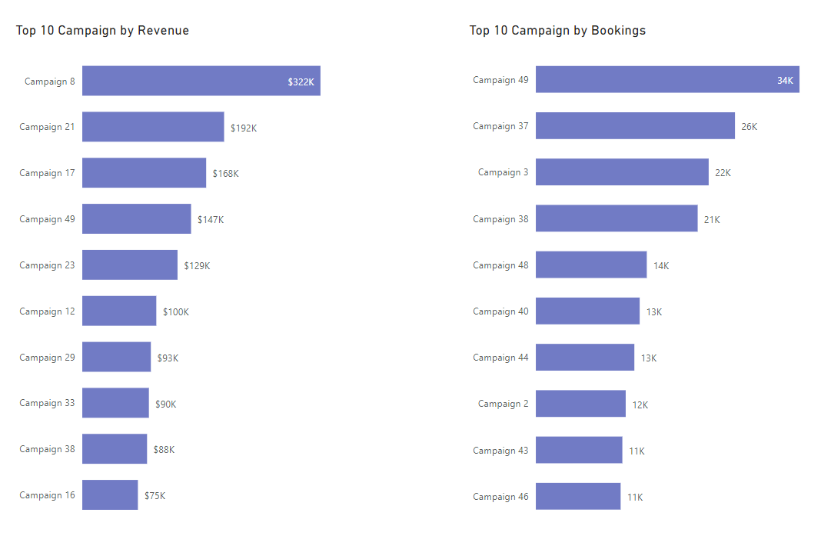
The most campaigns in terms of Revenue and Booking
The most campaigns that have high revenue defferent from the campaigns that have high booking !! Why ??
continue to know the result .

Slide 5
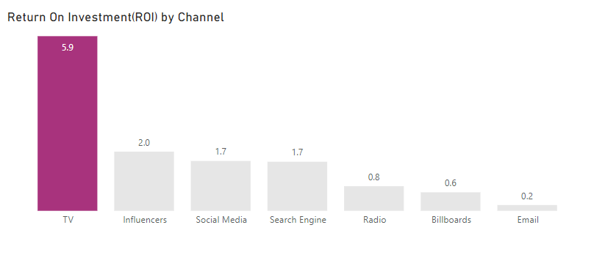
Which channels yield the highest return on investment (ROI)
TV Channel is the most channel has highest return on investment

Slide 6
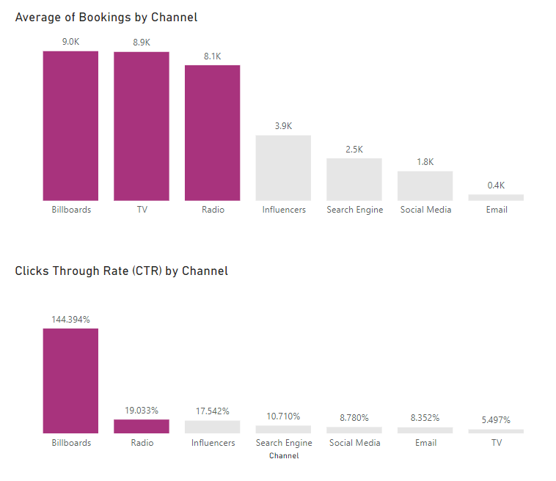
Which channels yield the highest Click Through Rate (CTR)
Billboards , TV and Radio Channels have the highest Bookings
Billboards channel has highest clicks per impressions or click through rate

Slide 7
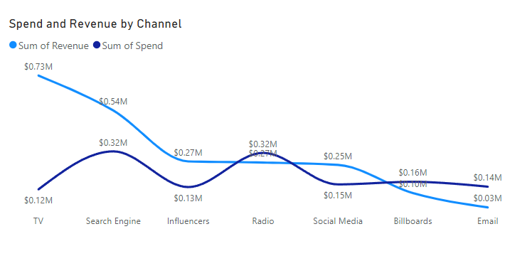
Impact the spend and revenue for each channel
TV Channel has the highest revenue and lowest spend
Email , Billboards and Radio channels have spend value more than the value of revenue

Slide 8

Overview

Slide 9
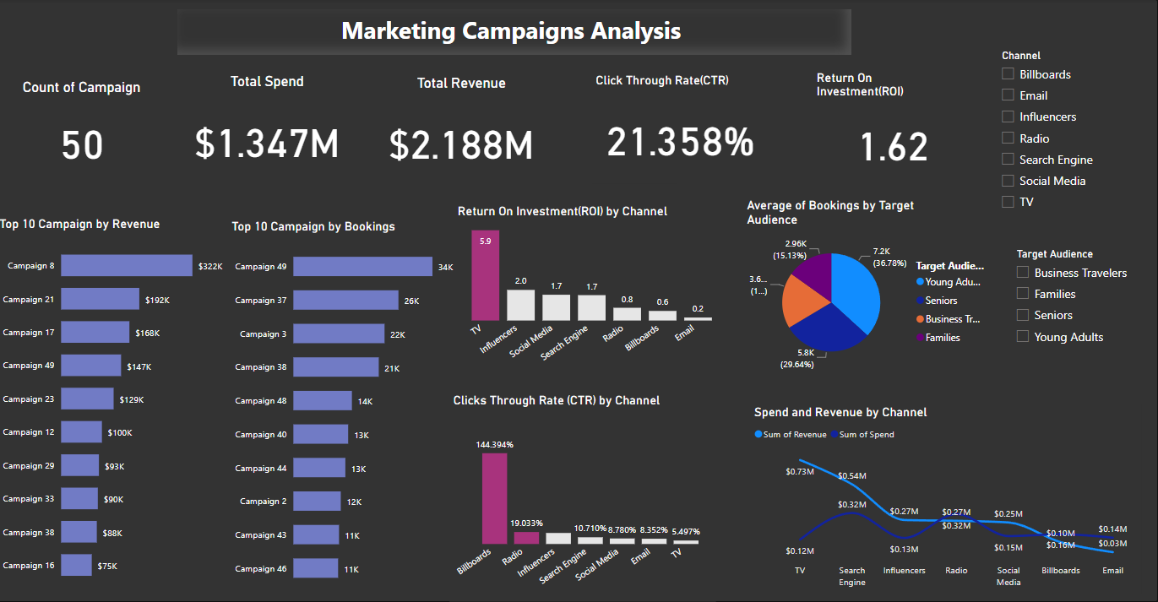

Slide 10

Summary and Recommendations
Financial Plan

Slide 11
Summary
Billboards and Radio Channels have the highest Bookings or CTR but have low revenue or ROI becouse their spend value is high
TV channel has high booking rate and revenue and low spend
Campaigns that have high booking rate different from campaign that have high revenue becouse the channels have high booking rate but not return low revenue becouse high spend value.
The most marketing campaigns strategy are Campaign 8 , 21,17 , 49,23,12,29,33,28,16 that use
TV , Search Engine and Social Media channels

Slide 12
Recommendations
The best way for marketing campaign is use TV channel and in the second level are Influencer , Search Engine and Social Media channels
don’t use Email , Billboards and Radio channels

